Slide 1
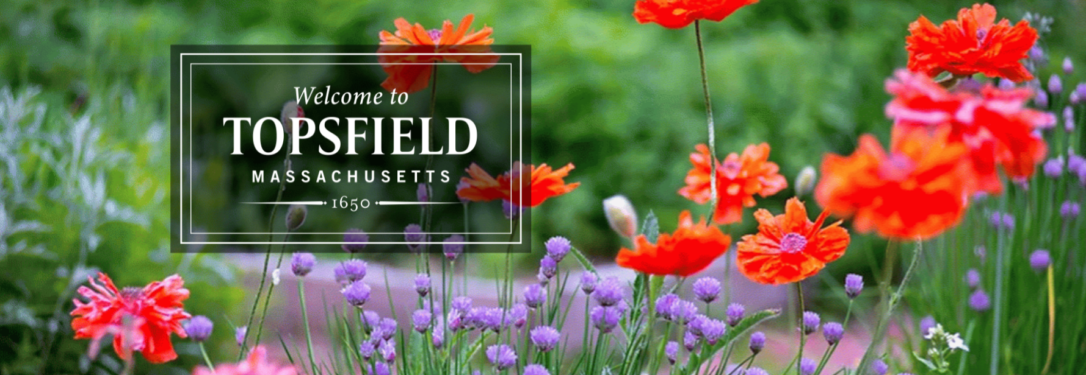
BUSINESS AND DEVELOPMENT SHOWCASE
June 7, 2022

Slide 2
Goals for Today
Provide Background on Topsfield
What we’ve been up to and what’s to come
Provide insight on certain Investment opportunities

Slide 3
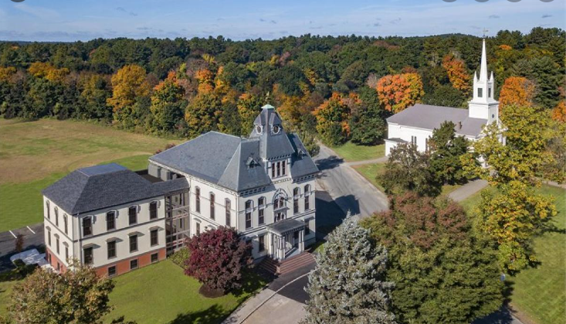
Background on Topsfield
Location
Population
Demographics: Local and Regional
Explore Topsfield
Housing Information
Our Business Community
Regulatory and more

Slide 4
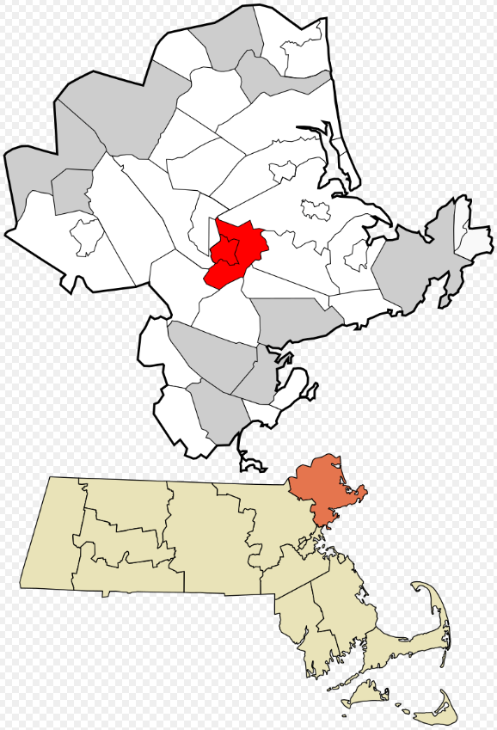
Location
Topsfield is the geographical center of Essex County MA
Accessibility
Interstate 95
Rt. 1
Rt. 97
Easy access to Boston (less than 20 miles driving)
Easy access to New Hampshire (less than 20 miles driving to the state boarder)

Slide 5
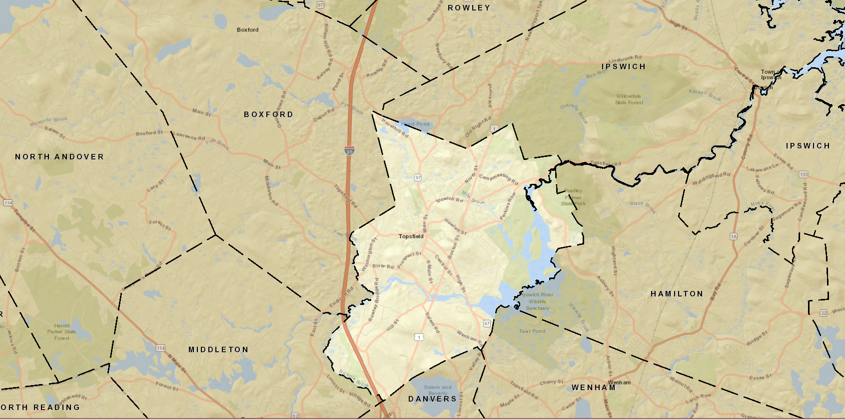
Populations of Surrounding Communities
6,569 Topsfield residents (as of 2020)
Almost 70,000 people live in Topsfield or in an adjacent community:
Danvers, Ipswich, Middleton, Boxford, Hamilton and Wenham
Total of 245,000+ people live in communities adjacent to or immediately outside of Topsfield:
Adjacent + Beverly, Peabody, North Andover, North Reading, Georgetown, Rowley, Manchester-By-The-Sea and Essex
798,698 people in Essex County (2020)

Slide 6
Demographics
Average age is 43.2 years old
Highly Educated
98% residents with High School Diplomas
66% residents with a Bachelor's Degree or higher
Average Median Income (2020)
Essex Country Household: $82,225
Average Adjacent Communities Household: $129,421
Topsfield Household: $144,258
High Level of Discretionary Income in Topsfield and surrounding communities

Slide 7
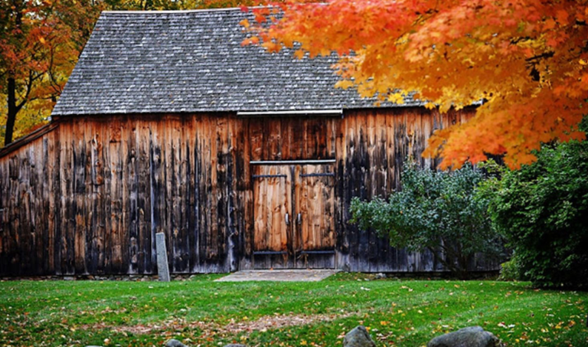
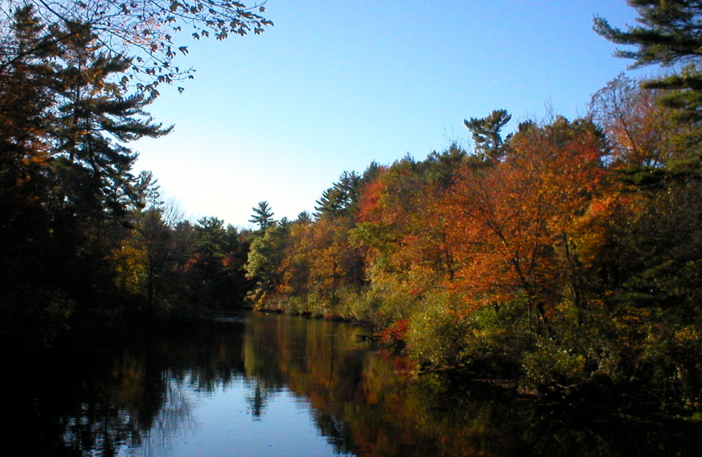
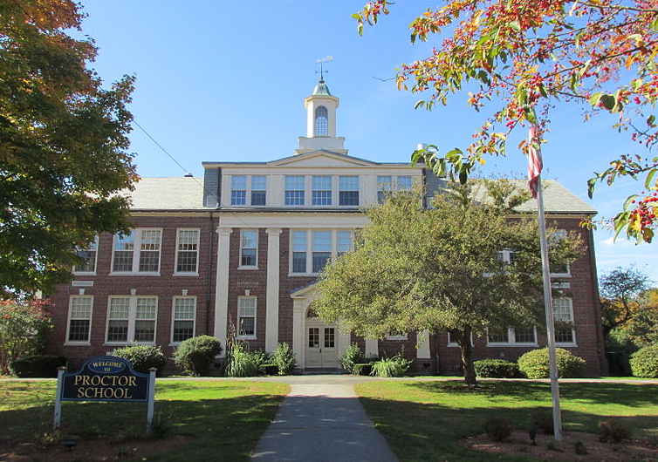
Explore Topsfield
Historic
Open Space and Recreation
Outstanding Schools
Town Events….

Slide 8
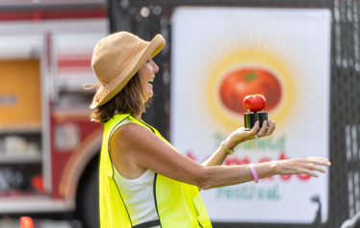
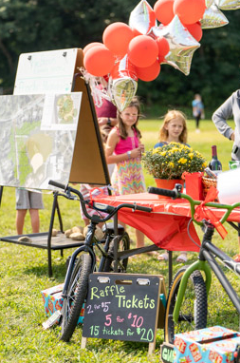
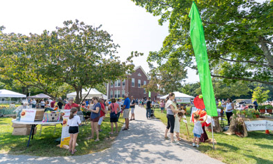
Annual Town Events
Flower Expo
Memorial Day Parade
Strawberry Festival – this Saturday
NEW Summer Farmers/Artisan Markets
Tomato Festival
Holiday on the Green
Ice Rink on the Common
Focused on placemaking and activating our spaces!!!

Slide 9
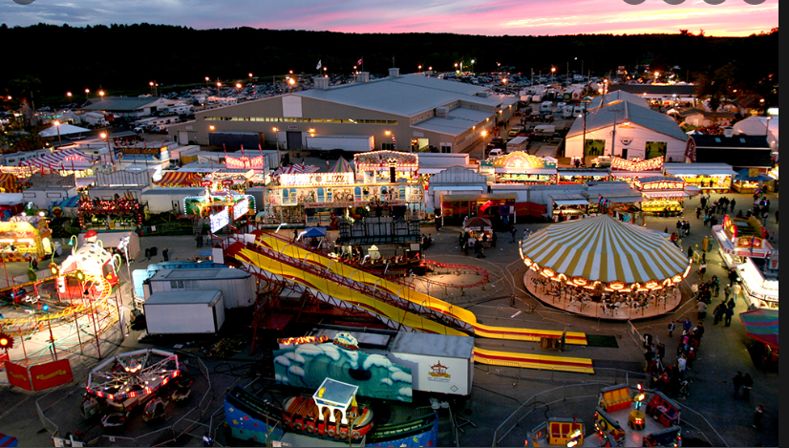
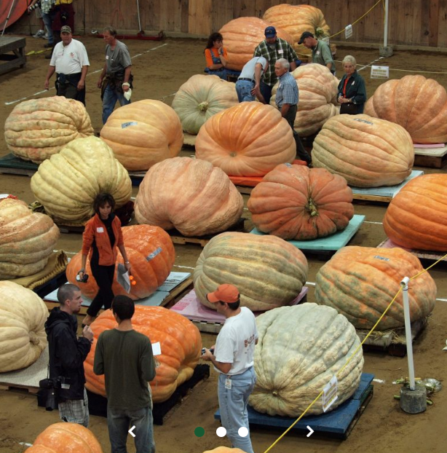
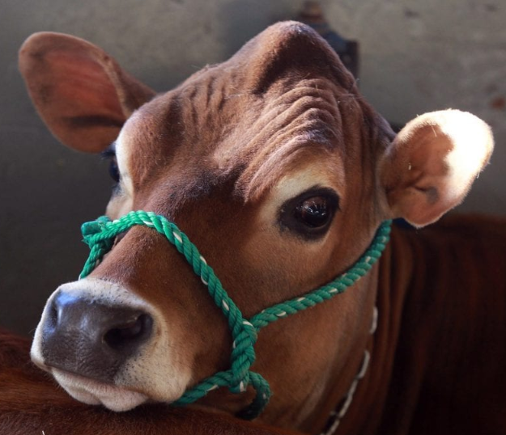
Founded in 1818
Known as America’s oldest country fair
500,000+ visitors during 11 days in October each year
Strong partnership between the Town and the Fair

Slide 10
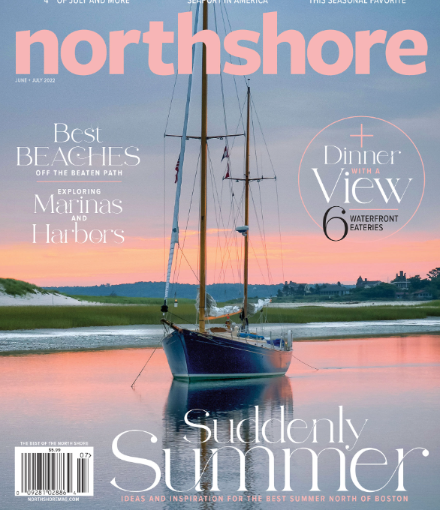
Housing
2,159 Housing Units (2020)
Predominantly Single Family Units
Average Home Sale Price is $720k
Lack of inventory to meet the demand
Currently two 40B projects in processes
Topsfield will have greater than 10% of its units considered affordable
2021 named one of North Shore Magazine’s “8 Top Neighborhoods to live north of Boston”

Slide 11
Business Community
4,811 Businesses within 15 minute drive of downtown Topsfield (as of 2018)
Existing Business Downtown and Route 1
Businesses that have recently opened Downtown
Perfectly Imperfect Gift Shoppe
Zumi’s Espresso
COMING SOON: A new Art Studio with classes
Needs: Restaurants, Health and Personal Care and Food Market (2019 Downtown Revitalization Study)

Slide 12
Regulatory and More
Zoning
Traffic Counts
Liquor Licenses
2019 Downtown Revitalization Strategic Plan
Support by the Town
Community Survey

Slide 13
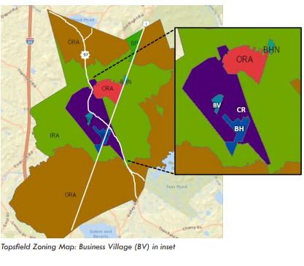
Zoning
Existing Zoning
Business Highway District (BH)
Business Village District (BV)
Central Residential (CRA)
Inner Residential and Agriculture District (IRA)
Outlying Residential and Agricultural District (ORA)
Business Park District (BP)
Elderly Housing District (EHD)
Business Highway District North (BHN)
Comprehensive Master Plan coming 2022!

Slide 14
Traffic Counts
Route 1 (at the Fairgrounds)
104,354 total vehicle trips (Sept. 1, 2020 through Sept. 18 2020)
115,331 total vehicle trips (May 21, 2022 through May 29, 2022)
Route 97/Main Street (near the Topsfield Common)
47,470 total vehicle trips (May 31, 2021 through June 7, 2021)
88,890 total vehicle trips (May 21, 2022 through May 31, 2022)

Slide 15
Liquor Licenses
Currently Taken
Three (3) All Alcohol
One (1) Beer and Wine
Two (2) Retail
One (1) Winery
Currently Available
Five (5) All Alcohol
Two (2) Retail
Competitive Annual Cost
$1,200/annual for All Alcohol, Retail or Beer and Wine

Slide 16
2019 MAPC Study - Downtown Revitalization Strategic Plan
Vision: A welcoming downtown village where Topsfield residents and visitors of all ages can live, work, gather and shop.
Goals:
1. Attract new businesses to the district
2. Increase the customer base to support downtown businesses
3. Enhance the look, feel and safety of the district
4. Increase community-building events
5. Expand town capabilities and resources to achieve goals

Slide 17
Support by the Town
New Water Treatment Facility
2019 Downtown Parking Study
Typical 40% - 50% utilization rate downtown
Project Review Team
Creation of the ECDC and TCP
Flower Planters, Parklet and General Beautification
Downtown Streetscape Design and Standardization
Branding
New Website
New Social Media Platforms
Innovative/Smart City Approach:
Solar Lights
Solar Bench
EV Charging Stations
Electrification of Town Vehicle Fleet
Grants
More

Slide 18
Competitive Grants Received 2019 -2021
Downtown Revitalization Strategic Plan/Parking Study $ 45,000
Design/Purchase of 20 Solar Lights $146,000
Purchase of Spring Flowers for Solar Lights $ 5,000
Solar Bench $ 5,000
Purchase of 21 planters for Main St. $ 15,000
Sidewalk Repairs/Extensions – Grove St. and Washington St. $ 384,000
Bump outs and Main Street Fall Decorations $ 2,000
Outdoor Eating Parklet $ 3,000
Installation of EV Charging Stations $ 45,000
Wayfinding Signs $ 100,000
Master Plan $ 100,000
Washington street Improvements $400,000
Main Street Holiday Trees $ 3,000
$1,250,000

Slide 19
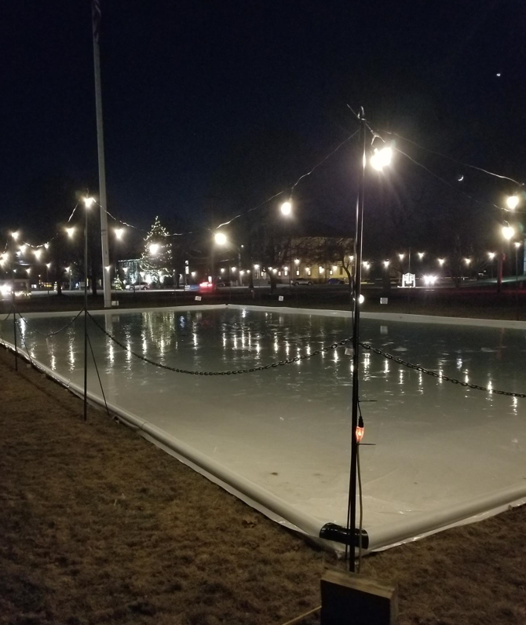
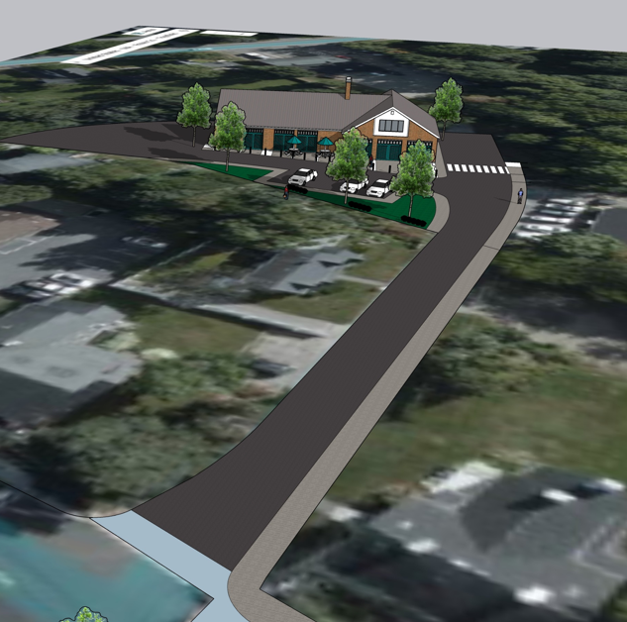
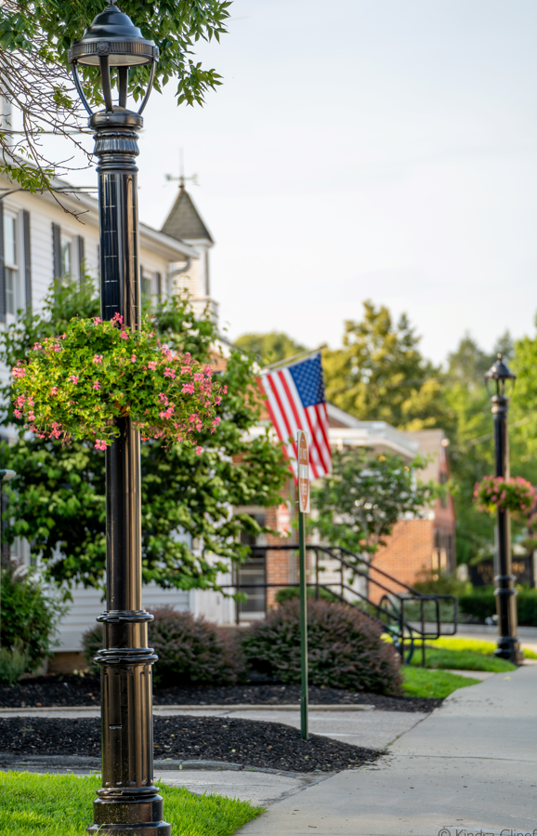
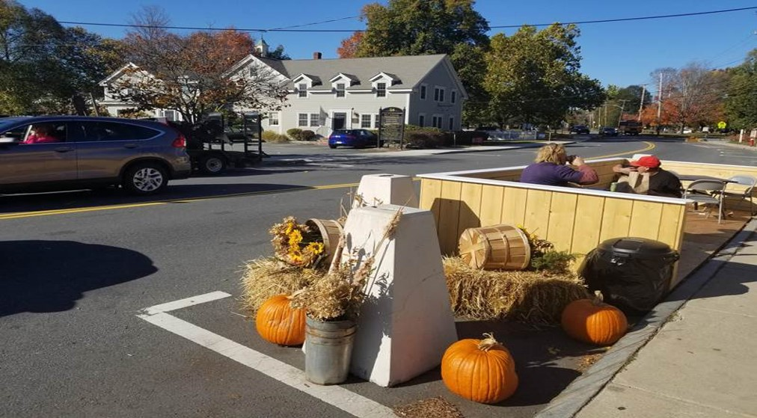
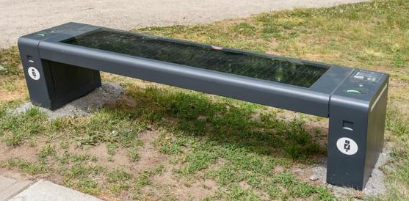

Slide 20
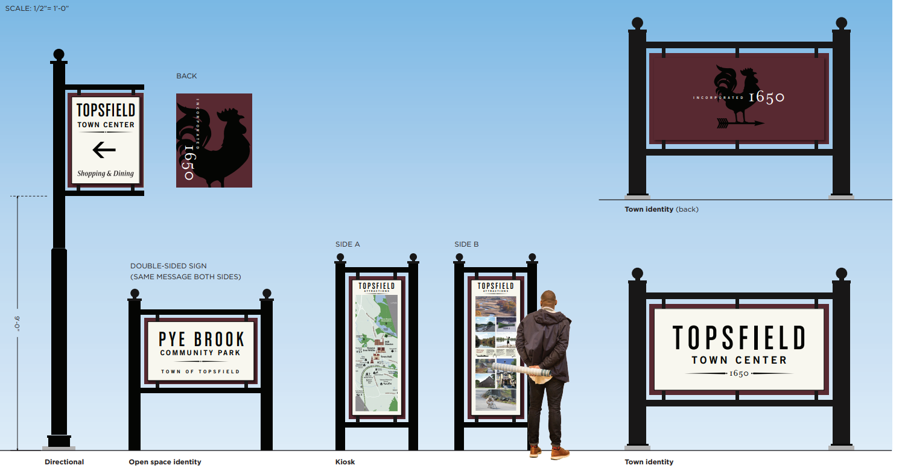
What’s to Come?
Wayfinding Signs Installation
Master Plan Implementation
Infrastructure Improvements on Washington Street
Music and Up-lighting Downtown
Additional Place Making
Expand Outdoor Dining
Create a Pocket Park Downtown
Regular Farmers/Artisan Markets

Slide 21
Community Survey, Spring 2022
264 Survey Respondents
Marketed via Town Website and Social Media
95% of Respondents were Topsfield Residents
Achieved good cross-section of Respondents by household size and age

Slide 22
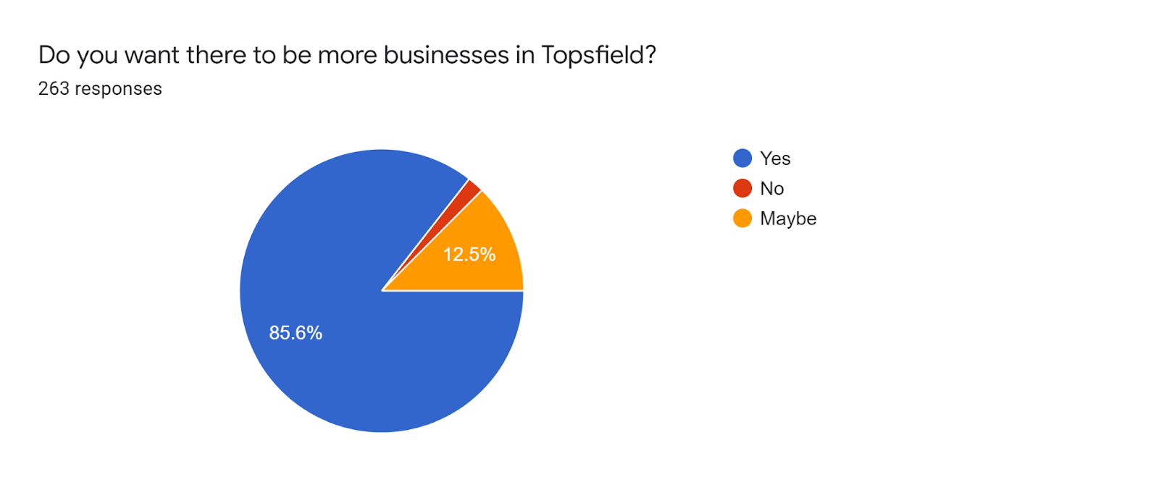
Community Survey, Spring 2022
Respondents overwhelmingly support increased business activity in Topsfield

Slide 23
Community Survey, Spring 2022
Respondents support increased business activity in both the Downtown and Route 1, especially for Restaurants and Retail

Slide 24
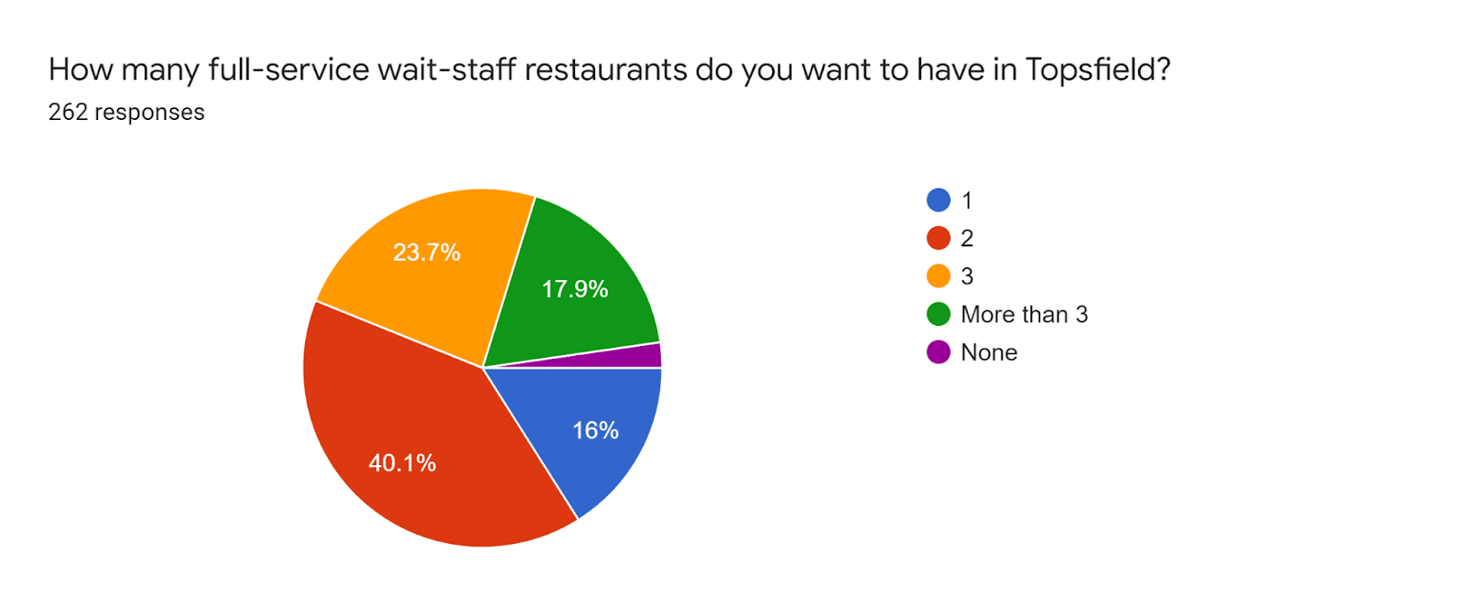
Community Survey, Spring 2022
Strong desire for Full Service Restaurants in Topsfield

Slide 25
Community Survey, Spring 2022
Market conditions are favorable for Restaurants
Low Competition
Food Service currently only makes up around 2% of Topsfield Businesses
Over 55% of Survey Respondents travel more than 20 minutes to dine out!
Strong Potential Customer Base
Almost 70% of Survey Respondents dine out 4 or more times a month
57% of Survey Respondents spend more than $200 dining out each month
Low Barriers to Entry
Supportive local government
Liquor licenses available

Slide 26
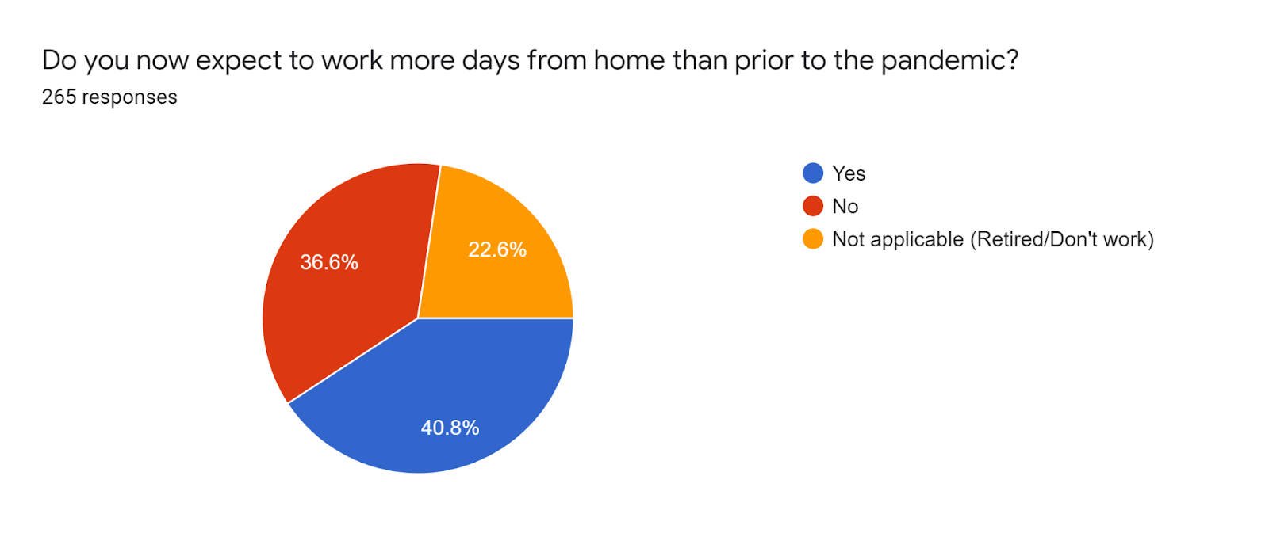
Community Survey, Spring 2022
Commuting behavior has changed since the pandemic: More Residents stay local

Slide 27
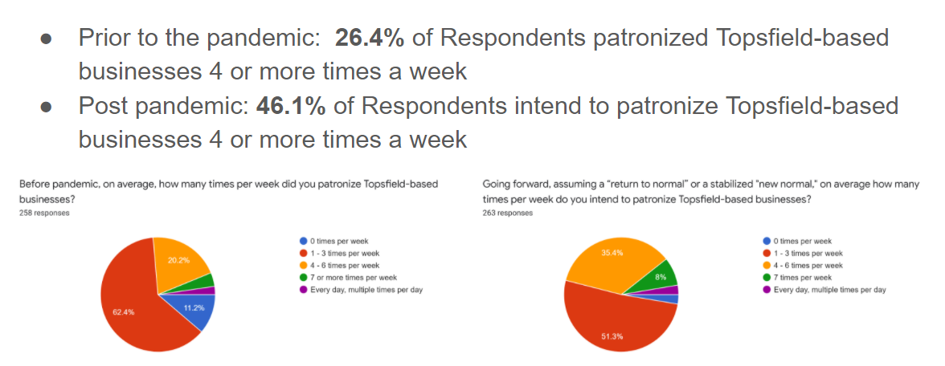
Community Survey, Spring 2022
Shopping habits have changed since the Pandemic: More Residents want to shop local

Slide 28
Community Survey, Spring 2022
“It would be nice to have a restaurant as there appears to be a lot of liquor licenses available and those that would greatly enjoy one have to drive to Rowley or Danvers to enjoy this”
“Restaurants please.”
“There needs to be more business geared toward people hanging out for more than 5 minutes so that people can see each other in town purposefully, but also meet organically while frequenting these businesses.”
“Please focus on destination restaurants that can pull traffic for downtown. We have enough quick service/fast food and need sit down options. Ideally 1-2 “good” restaurants can serve as anchors for other retail/services downtown.”
“We like consistent good food and a “good pour” of wine. We enjoy to stay local and just get out for a nice meal.”
“Prefer businesses that will provide services for residents of Topsfield and neighboring towns as well as those that can contribute to the tax base in an appropriate manner reflecting the residential character of the town. Mix of businesses should promote walkability downtown (smaller shops, restaurants) as a dining and retail destination, and continued larger businesses (light industrial, chain stores, shopping centers) on the highly trafficked Route 1 corridor.”

Slide 29
Opportunities
30 Main Street
448 Boston Street
Old Highway Garage

Slide 30
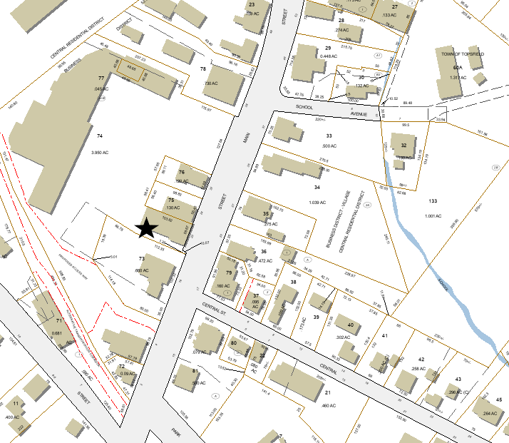
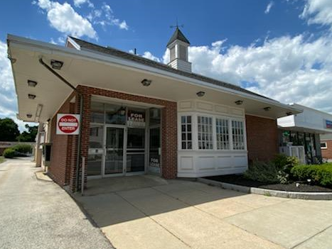
30 Main Street (Former Santander Bank)
Centrally Located Downtown
Building Description:
3,900 SF
Brick Façade
Ample parking
Perfect Restaurant Option
Septic capacity

Slide 31
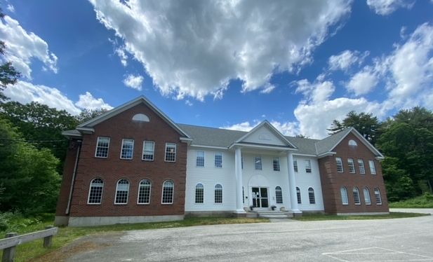
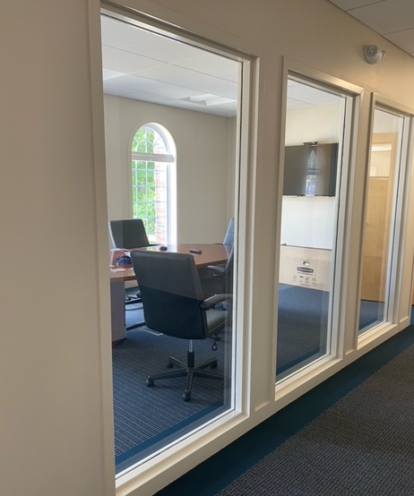
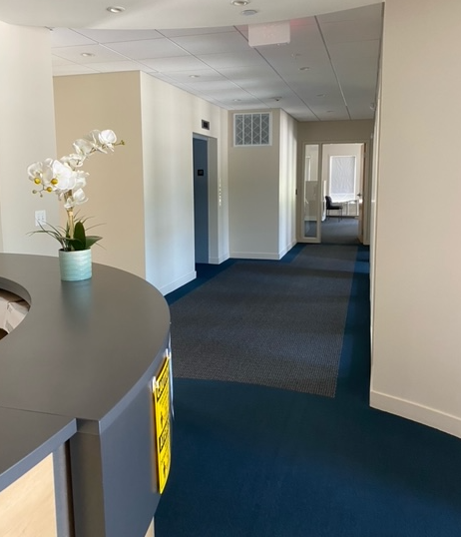
448 Boston Street (Route 1)
10,500 SF Office Space + additional 5,000 SF of storage, cafeteria and IT space on 1st fl
Potential corporate Headquarters

Slide 32
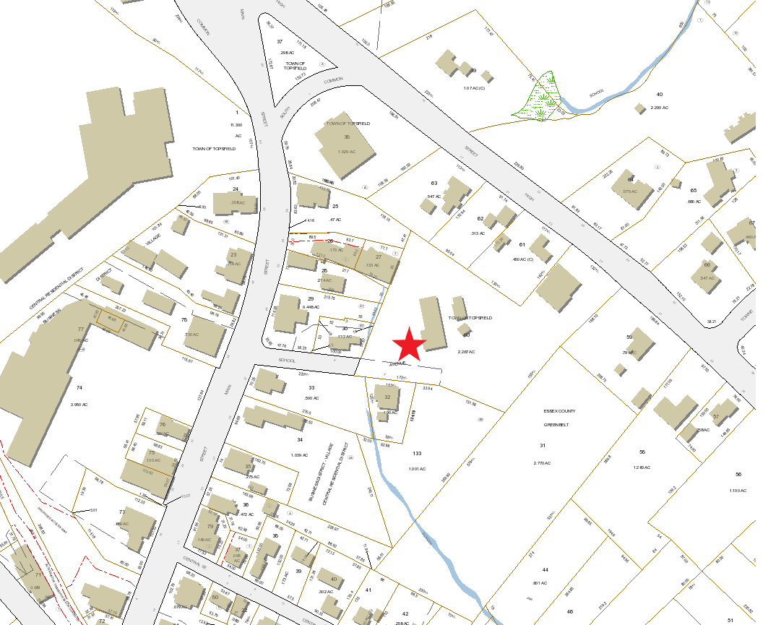
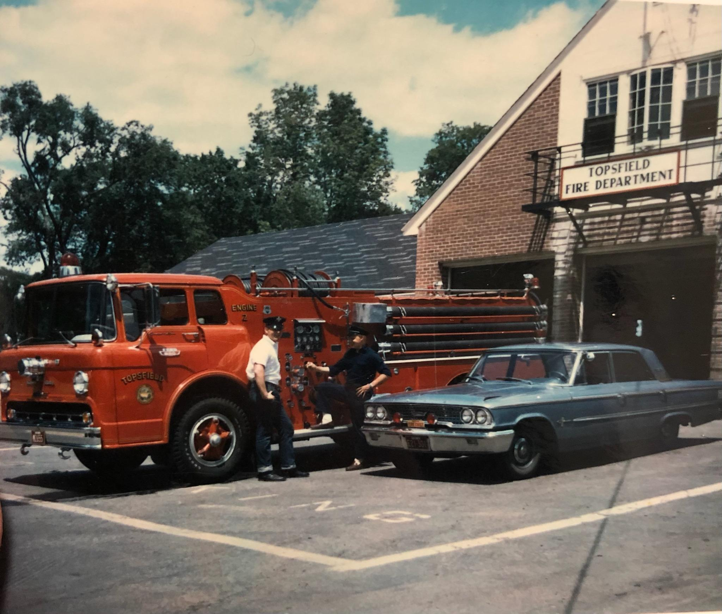
The Old Highway Garage and Fire Station
History of the Building
Built circa 1941
Former Fire Station
Former Highway Garage
Current Use
The Opportunity
Centrally located
Town Controlled

Slide 33
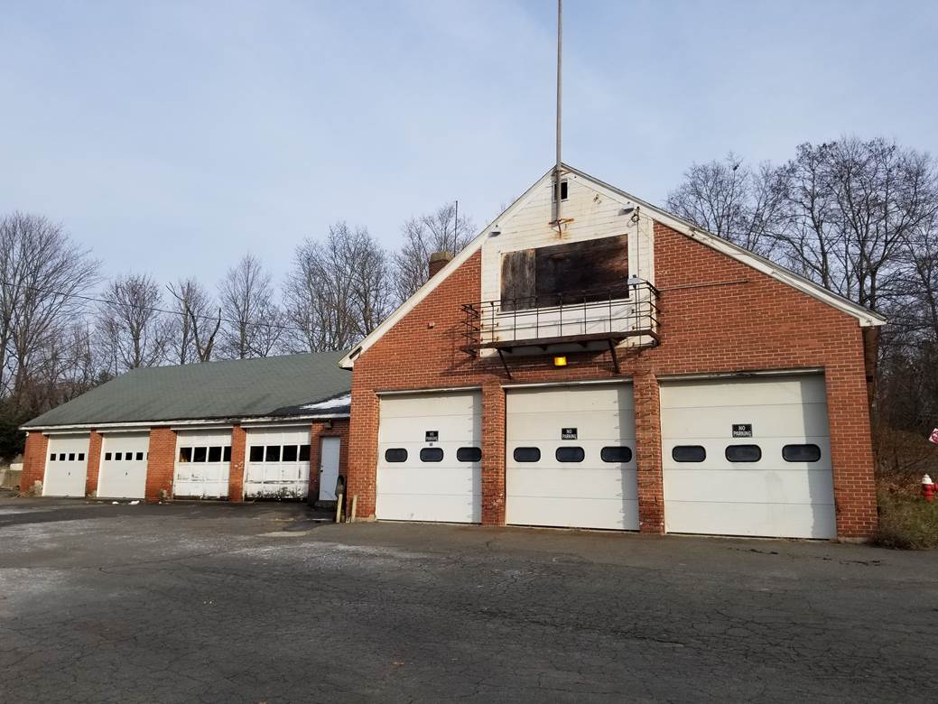
Considerations
Owned by the Town
Building Description:
2.27 Acre Lot (includes FS)
3,644 SF (+325 SF Mezz.)
High Bays
Brick Facade
Easily Subdivided
Business Village Zoning
Conservation
General Environmental
Septic

Slide 34
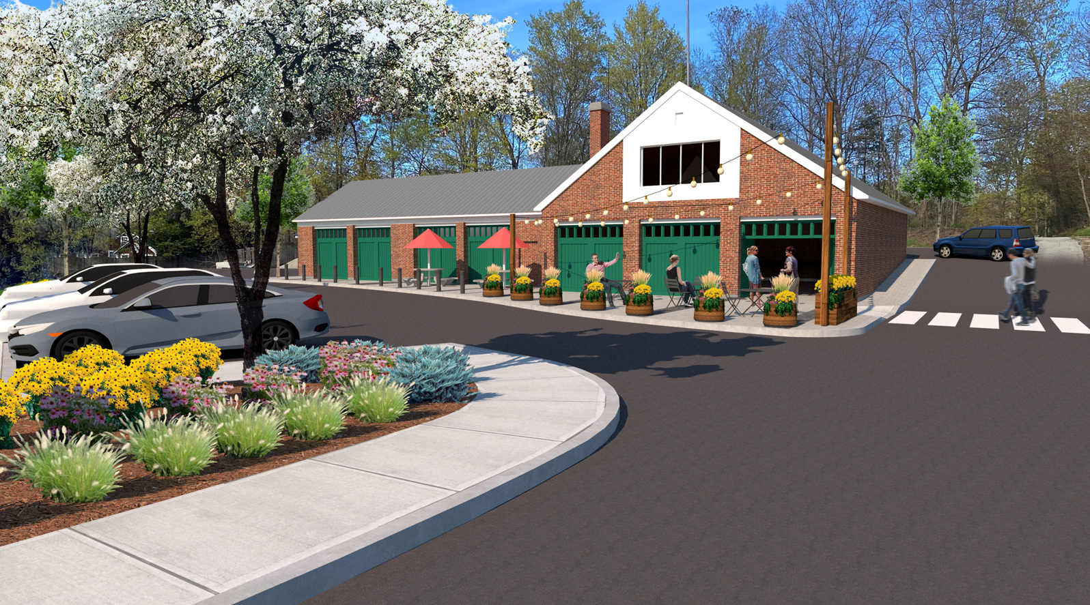
Unlocking Future Possibilities
Community Input
Subdivision Approval
Town Meeting Approvals
Zoning Change
Disposition
Request For Proposal (RFP)

Slide 35
Conclusion
Why Topsfield?
Creativity, Communication, Persistence and Passion
Stream lined processes and direct line of communication with decision makers
Our commitment to Partnerships
The Community, Business/Property Owners and Municipal Leadership
Surrounding ourselves with smarter people than us
The Opportunities

